Slide 1
Introduction to Three Phase System
Md. Tariqul Islam

Slide 2
Title and Content Layout with List
After the ending of this lesson, students are able to know about
Delta Delta Configuration with mathematical analysis
Wye Delta configuration with mathematical analysis
Wattmeter Connection

Slide 3
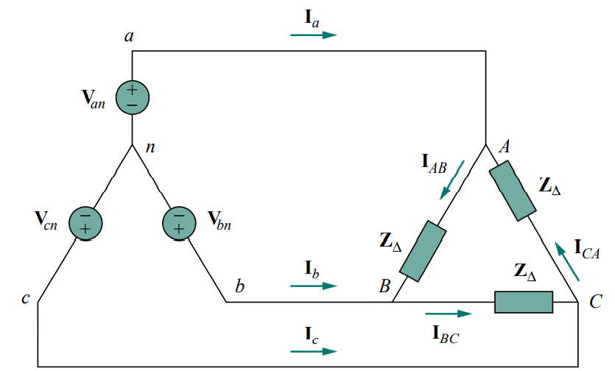
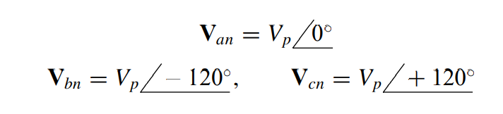
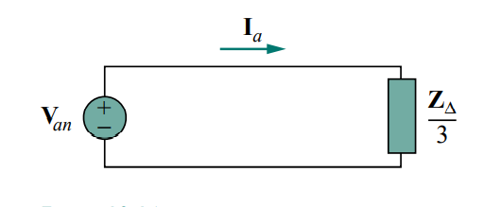
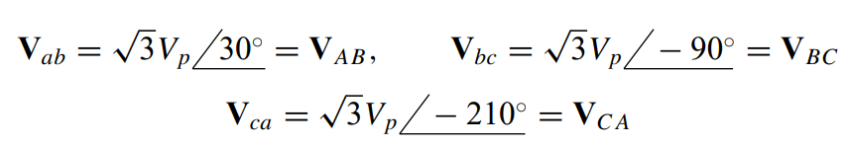
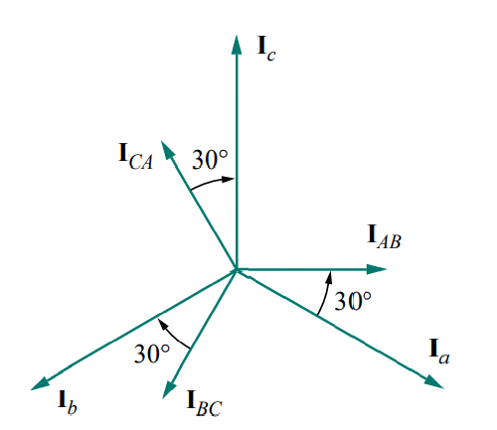
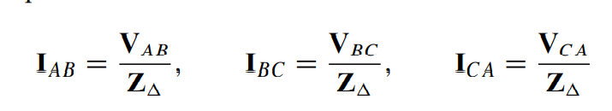
BALANCED WYE-DELTA CONNECTION
What is wye-delta system?
A balanced Y-∆ system consists of a balanced Y-connected source feeding a balanced -connected load.

Slide 4
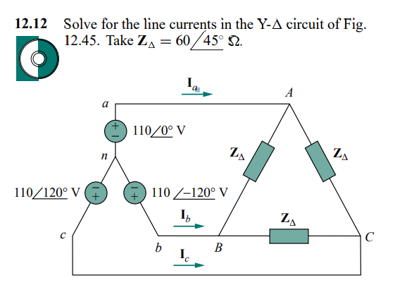
Problem

Slide 5
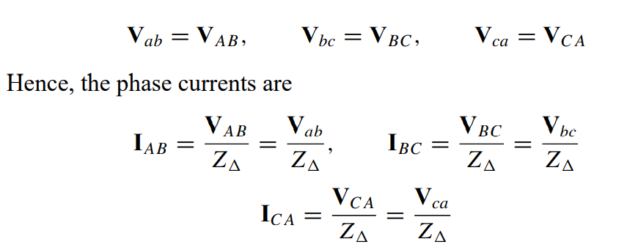
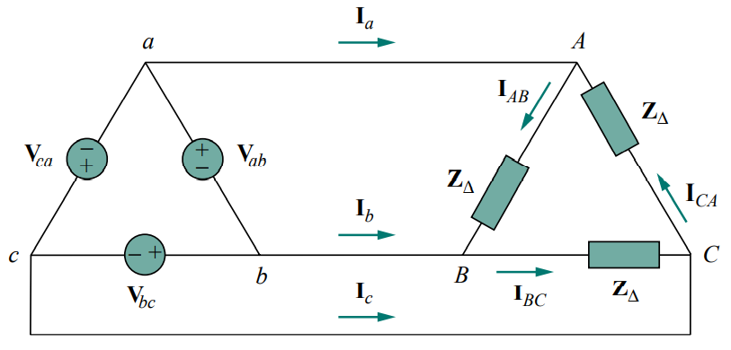
BALANCED DELTA-DELTA CONNECTION
What is Delta-Delta connection?
A balanced ∆-∆ system is one in which both the balanced source and balanced load are -connected.
How can you calculate Ia, Ib and Ic?

Slide 6
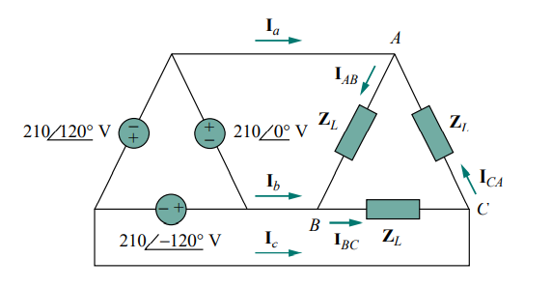
Problem
Refer to the - circuit in Fig. 12.49. Find the line and phase currents. Assume that the load impedance is 12 + j9 per phase.

Slide 7
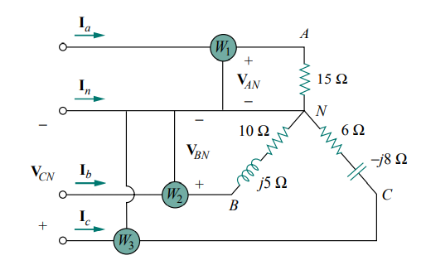
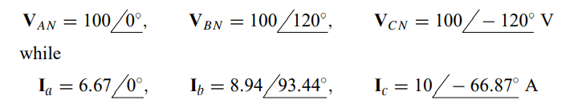
Wattmeter Related Math
Predict the wattmeter readings.

Slide 8


